Slide 1
Learning Microsoft BI – Where to Start
Kashif Wasim
Pareto Systems | Founder & Principal
kashif.wasim@paretosys.com
www.paretosys.com

Slide 2
About Me
Business Intelligence Consultant (Architect, Lead, Developer)
Founder & Principal at Pareto Systems LLC (www.paretosys.com)
In IT for 16 years.
10 years of Microsoft BI consulting experience
Certifications
Microsoft Certified IT Professional – Business Intelligence Developer 2008
Microsoft Certified IT Professional – Database Administrator 2008
Microsoft Certified Technology Specialist – SQL Server 2008, Business Intelligence Development and Maintenance
Microsoft Certified Technology Specialist – SQL Server 2008, Implementation and Maintenance
Microsoft Certified Technology Specialist – Microsoft Windows SharePoint Services 3.0, Application Development
Microsoft Certified Technology Specialist – Microsoft Windows SharePoint Services 3.0, Configuration
Microsoft Certified Technology Specialist – SQL Server 2008, Database Development
Microsoft Certified Technology Specialist – Microsoft Office SharePoint Server 2007, Configuration
Microsoft Certified Technology Specialist – SQL Server 2005

Slide 3
Where to Start?
Master Relational Database concepts
Learn Normalization (3rd Normal Form)
Learn De-normalization (Star/Snowflake)
Learn Multidimensional concepts Free E-Book: Dimensional Modeling: In a Business Intelligence Environment
http://www.redbooks.ibm.com/abstracts/sg247138.html

Slide 4
Learning Track
Learn SSRS
Learn to develop Reports/ Dashboards using SSAS data source
Learn to create
and load data into a data warehouse
Learn SSAS
Master T-SQL Queries
Learn SSIS

Slide 5
Free Video Trainings
Youtube - Wise Owl tutorials (T-SQL, SSRS & SSIS)
Microsoft Virtual Academy www.microsoftvirtualacademy.com
Training Courses
Live Events - Jump Start (Live & Recorded sessions)
For Certifications (70-461, 70-462 & 70-463), see recorded Jump Start sessions.
Querying Microsoft SQL Server 2012 Databases
Administering SQL Server 2012
Implementing a Data Warehouse with SQL Server
Video Blogs www.msbiacademy.com

Slide 6
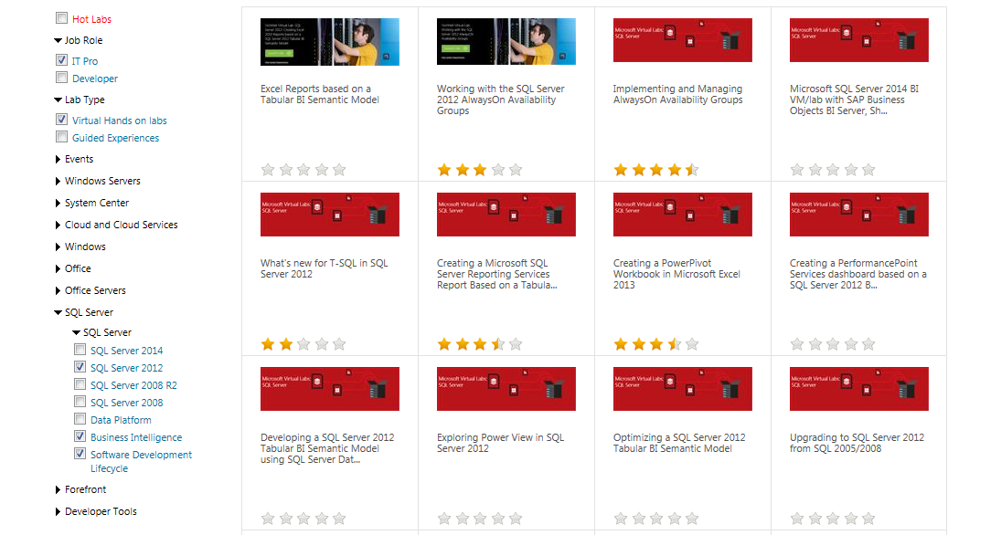
TechNet Virtual Labs
http://technet.microsoft.com/en-us/virtuallabs

Slide 7
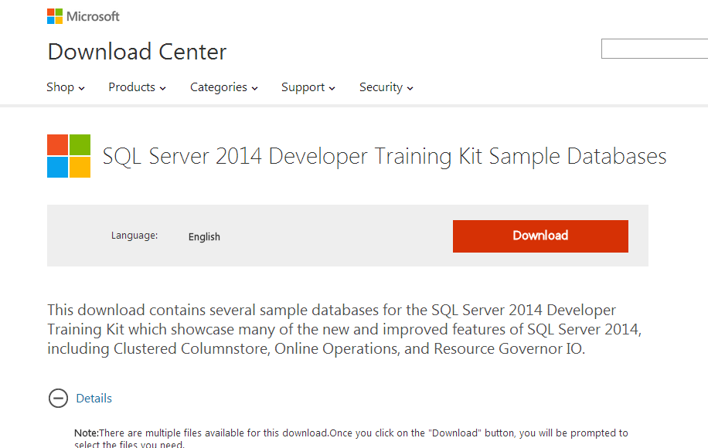
SQL Server 2014 Developer Training Kit Sample Databases
http://www.microsoft.com/en-us/download/details.aspx?id=41700

Slide 8
Free E-Book Gallery (TechNet)
http://social.technet.microsoft.com/wiki/contents/articles/11608.e-book-gallery-for-microsoft-technologies.aspx

Slide 9
Questions/Comments?

